Slide 1





Challenge Partners
Arizona Autism Charter Schools
Arizona, USA
autismcharter.org
First Place
AZ
Arizona, USA
firstplaceaz.org/
Specialisterne
Mexico
specialisternelatam.com/
Kairós Inclusión
Mexico
Kairosconsultorias
.com
Surfeando la Neurodiversidad
Mexico
tqueremos.tec.mx/es/surfeando-la-neurodiversidad
Notes:
Muchas gracias, Ursula. We’re also honored to be joined today by representatives from our five Challenge Partners, service minuted organizations, programs, or service providers supporting neurodivergent individuals.
Thank you to Arizona Autism Charter Schools, First Place AZ, Special-EE-sterne, KAIROS Inclusion and Surfeando la Neurodiversidad for supoorting our student teams across this challenge and ensuring that their solutions are grounded in lived experience, institutional realities, and real user needs.You’ll meet your Challenge Partners and learn about their communities and ways of working later in our program.

Slide 2
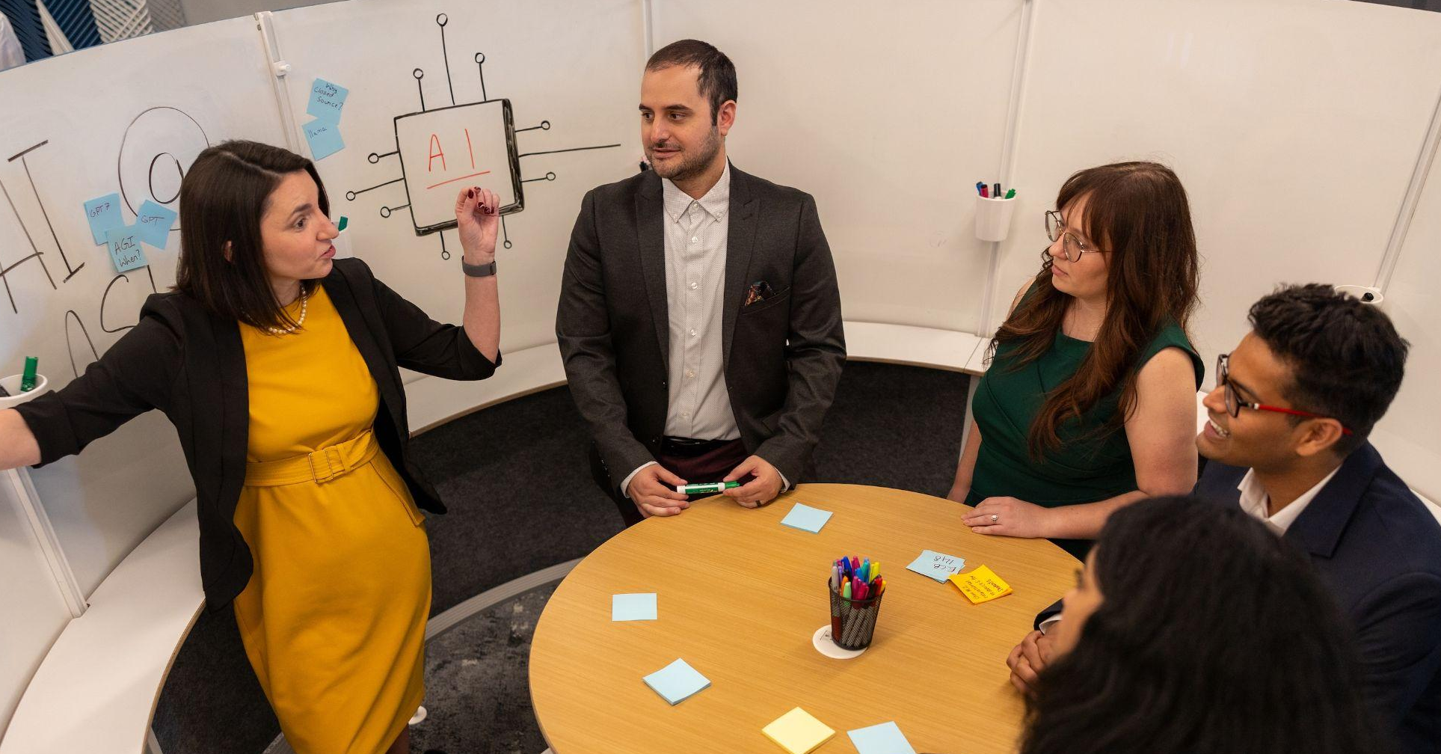
About the Challenge
From Oct. 24 to Nov. 21, the North American AI Challenge invites student teams, higher education institutions and service-minded organizations from across North America
to advance AI for neurodiverse learning.
This accelerated design and venture challenge invites students to prototype and pitch AI-driven ventures that support neurodivergent young people, while engaging higher education institutions and service-minded organizations across North America as partners and collaborators.
Customer research
Hub-and-spoke model
Student Sinema Prize
A core requirement of the Challenge is direct customer and market research. Teams must conduct customer research through a Challenge Partner, a curated list of institutions, programs, or service providers supporting neurodivergent individuals, ensuring proposals are grounded in real user needs.
Our Launchpad model operates as a regional hub-and-spoke designed to ensure research integrity, equitable access, and high-quality live competition experiences. Participation is designed to prioritize in-person engagement and verified customer research.
Powered by real-world customer research conducted with vetted neurodiversity-serving partners, student teams will prototype and pitch venture-ready AI solutions through a competitive regional Launchpad model, with top teams advancing to a live grand finale in Phoenix, Arizona for the $15,000 Sinema Student Prize.
Notes:
Where we will select top teams to advance to the grand finale of pitching and demoing in Phoenix, AZ, competing for the incredible $15,000 Sinema Student Prize.

Slide 3

The Challenge
Work as a team to build intelligent systems that decode "executive function" — the mental skills we use to plan, focus, and juggle tasks — to better support individuals with ADHD, autism, dyslexia, and other neurodiversity, informed by real-world customer research and support from a Challenge Partner.
Teams will prototype and pitch their solutions live to a jury panel at a regional Launchpad event, using a required 5-slide, 5-minute presentation template. Advancing teams will compete for the Sinema Student Prize in a final round of live pitches on Nov. 21 in Phoenix, USA.
Notes:
Your challenge over the next two weeks is to work together with Challenge Partners to build intelligent systems that decode the mental skills we use to plan, focus, and juggle tasks to better support individuals with ADHD, autism, dyslexia, and other neurodiversity, informed by real-world customer research.
You ar expected to prototype and pitch your solutions in early November using a required 5-slide, 5-minute presentation template. Up to 4 teams will compete in the final round on Nov. 21.

Slide 4
In this competition, student teams will:
Conduct direct partner research
Prototype a functional MVP
Present and demo live
Engage with an assigned Challenge Partner (a vetted institution, program, or service provider) to ground proposals in lived experience, institutional realities, and real user needs.
Build an original, working functional Minimum Viable Prototype (FMVP) that incorporates AI and partner research within the intensive two-week design sprint.
Pitch live in-person at a regional Challenge Launchpad by Nov. 7 to earn a spot at the live grand finale on Nov. 21 in Phoenix, Arizona to compete for the $15,000 Sinema Grand Prizes and seed funding, as well as global showcase opportunities.
Notes:
Putting it simply, in this challenge, teams are expected to Conduct direct partner research, Prototype a functional MVP and Present and demo live.

Slide 5
Challenge deliverables
5 minute presentation (using require deck) introducing team, problem statement, solution, and demo scenario that must reference customer research with a Challenge Partner
Minimum Viable Product (MVP) prototype of AI-powered tool
Business Model Canvas for your venture
URL to team GitHub, includes info with a custom script URL
PDF of AI prompts
URL to your pitch deck
Written responses via submission form
Notes:
Your challenge deliverables include these required components:
We will review each of these deliverables in details in a few minutes.

Slide 6
Challenge Timeline
Oct. 24 - Kick off!
Oct. 25 through Nov. 5
Nov. 5, 11:59 p.m. MT
Challenge kick off Join online to review challenge overview, enjoy keynotes from challenge experts, and begin team ideation.
Design sprint Teams design, conduct research with a Partner, prototype their solutions for submission on Nov. 5 at 11:59 p.m.
Submissions due All teams will submit their project deliverables to Airtable on Nov. 5, 11:59 p.m. MT.
Notes:
Let’s take a look at the phases of the challenge timeline. Phase 1 starts today with our kick off, and starting tomorrow you’ll begin your 2 week design sprint and meet with your Challenge Partners. This phase is where all of your dev work, research and prototyping will take place. All submissions are due on Thursday, Nov. 5 at 11:59 p.m. MT.

Slide 7
Challenge Timeline
Nov. 6
Nov. 7
Nov. 8-10
Nov. 21
Scottsdale Launchpad, USA
Monterrey Launchpad, MEX
Code review Top-ranked projects will undergo a code review following pitches to confirm originality, verify AI usage, and officially validate prize distribution.
Grand finale Advancing teams compete in Phoenix, AZ at the grand finale featuring pitches, demos and awards ceremony!
Teams pitch and demo their solutions live to an expert panel of evaluators. Each Launchpad selects two top teams to advance to the grand finale. Finalists and tentative winners will be announced live based on judge scoring. Official placement and prize distribution remain subject to a post-pitch code audit to verify authenticity, AI usage compliance, and project originality.
Notes:
The next phase is dedicated to your presentations and demos. All teams are invited to pitch live and demo their solutions at a regional launchpad event, held either Nov. 6 in Scottsdale, USA or Nov. 7 in Monterrey, Mexico. Teams, please check your emails for your Launchpad assignment, and contact me directly on Discord or email if you have any questions.
At each Launchpad, teams will present to the jury using the 5 slide- 5 minute template, followed by up to 5 minutes of Q&A with the jury. At the end of each Launchpad, jury will deliberate to select the two top teams to advance to the final round. These announcements are provisional, as top-ranked projects will undergo a code review following pitches to confirm originality, verify human-in-the-loop AI usage, and officially validate prize distribution. We’ll confirm rankings by Nov. 10, and announce next steps for competing in the final round on Saturday, nov. 21 in Phoenix, AZ.

Slide 8
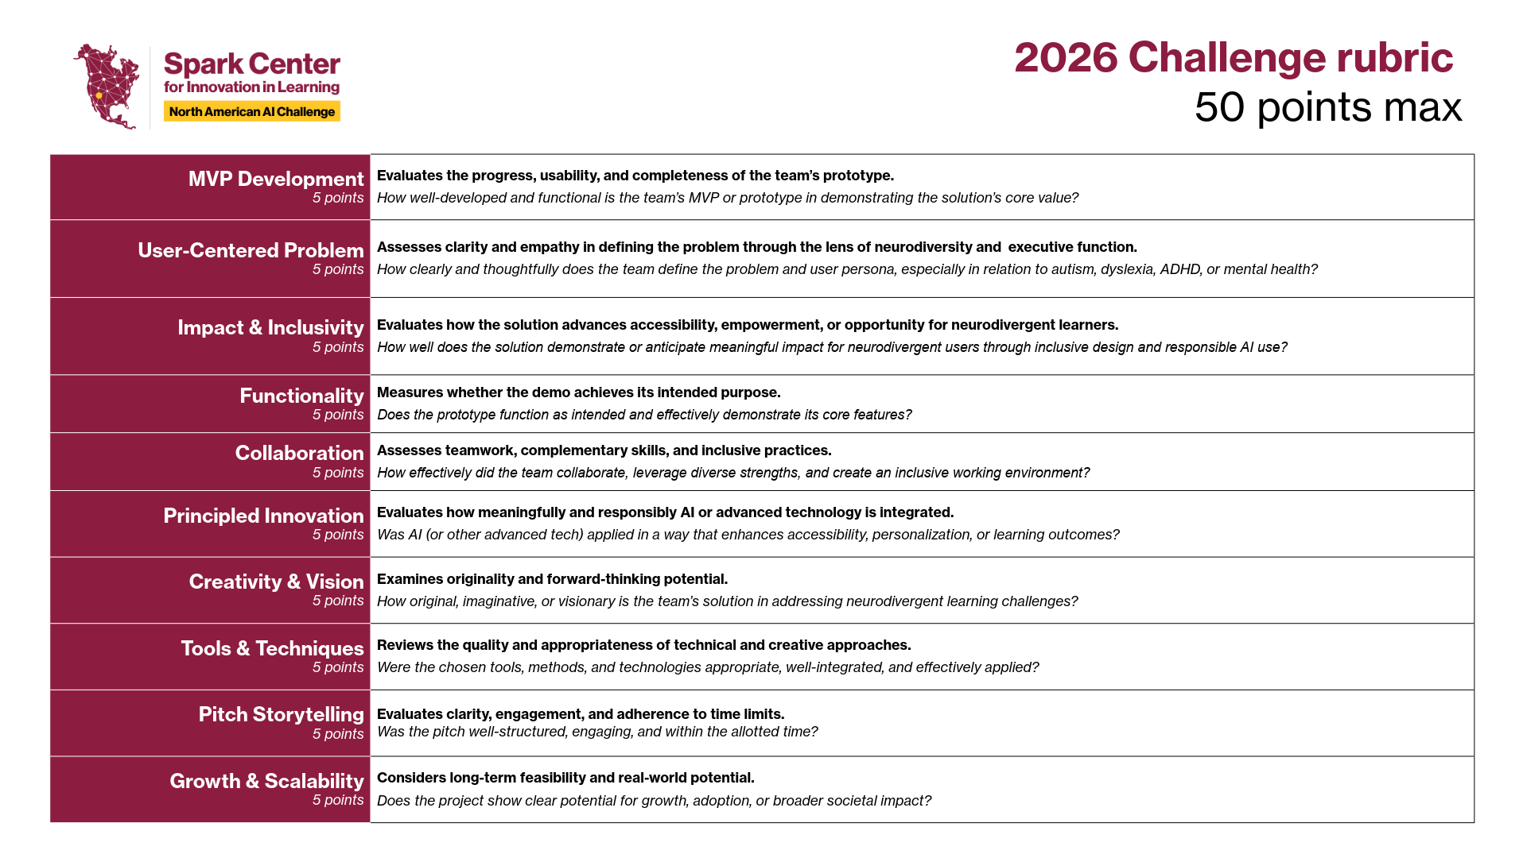
Notes:
At both the Regional Launchpad and the grand finale, teams will be evaluated across a 10-question rubric totaling up to 50 points, measuring MVP development, user-centered design, impact, functionality, collaboration, principled innovation, creativity, tool application, pitch storytelling, and long-term scalability. TEams, this rubric is available in your Presenter Packet, which we’ll share with you during our break shortly.

Slide 9
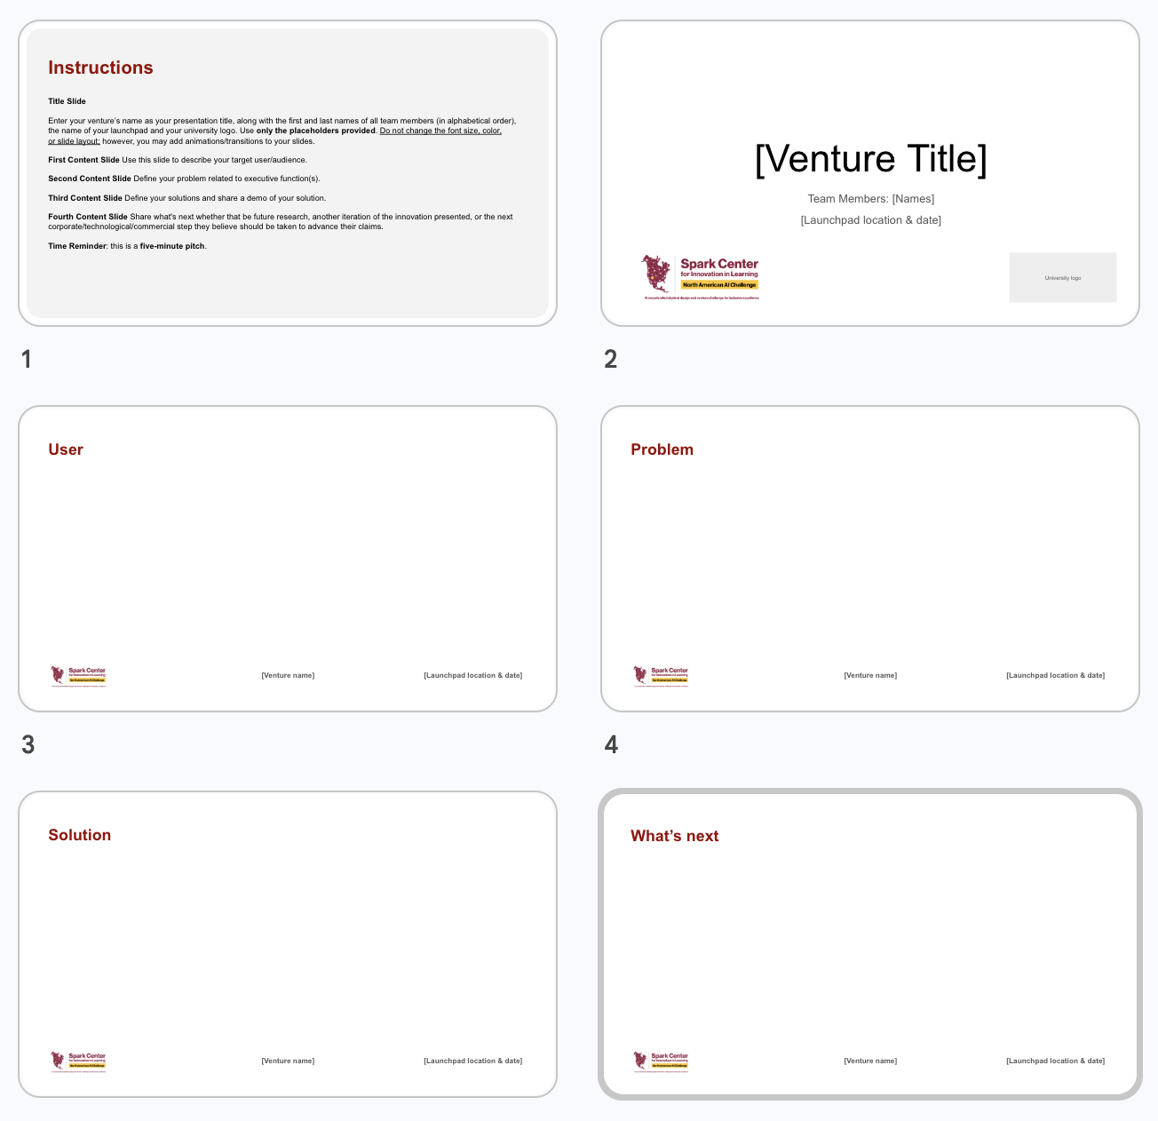
5-minute live presentation
All teams must use the required challenge slide deck, complete with 5 slides.
Introduce the team, problem statement, solution, and demo scenario, as well as referencing customer research with a Challenge Partner.
Use the prescribed slide deck and timer function included in the Presenter Packet.
The presentation may not exceed 5 minutes.

Slide 10
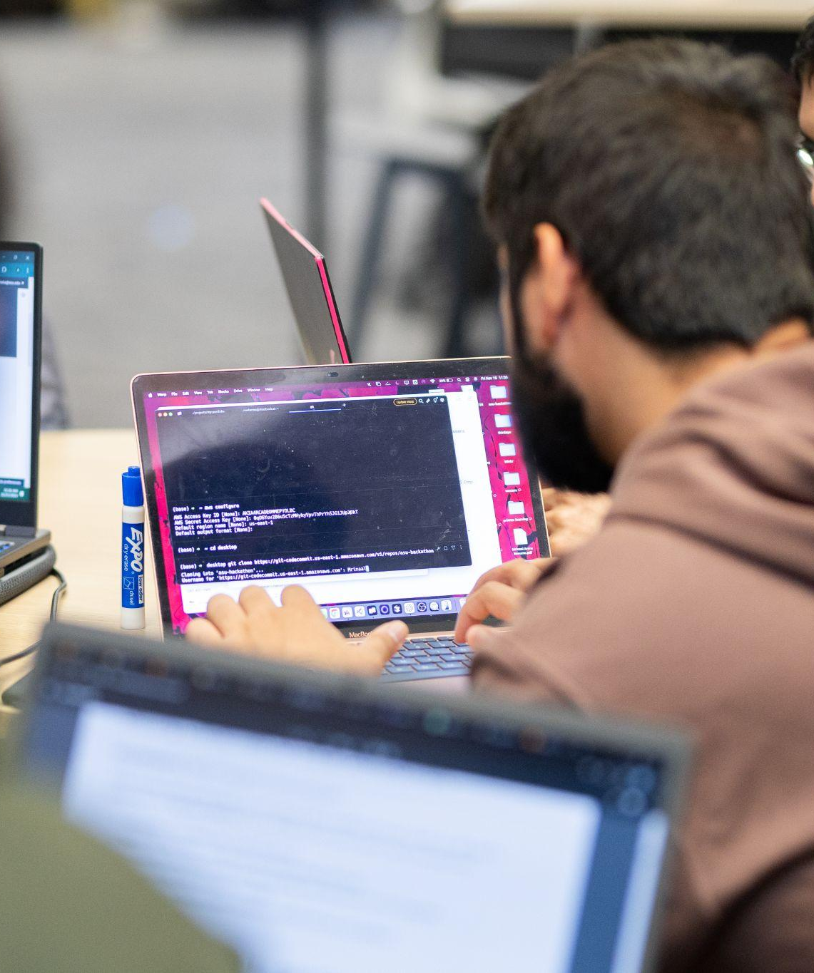
Functional Minimum Viable Product (MVP)
Your functional MVP must be an original, working prototype that demonstrates the core value of your AI-powered solution. It does not need every future feature. It does need to work well enough for the jury to understand the intended user experience and evaluate the role of AI.
Avoid the generic focus app. A timer, reminder list, or task tracker is not enough on its own. Show a distinct, research-informed AI capability and a clear reason it matters in the user's real context.

Slide 11
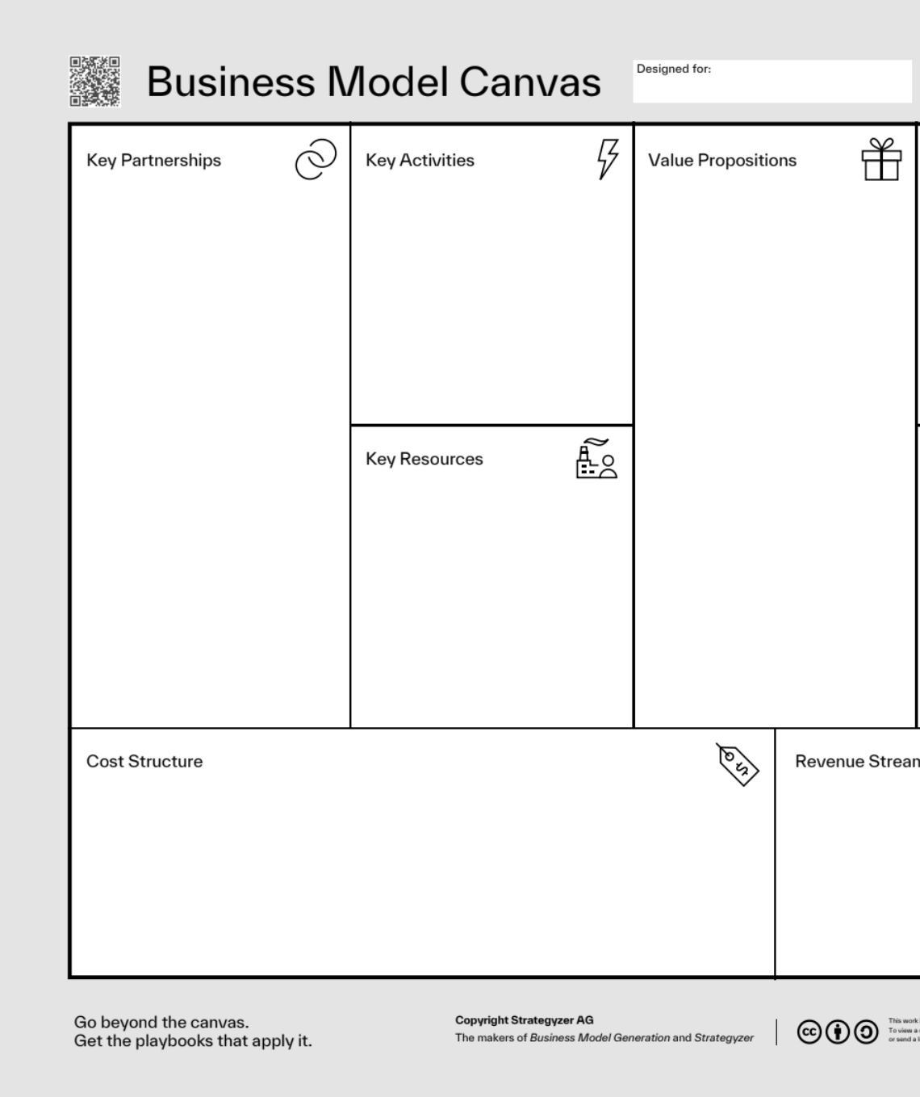
Business Model Canvas (BMC)
Included in the Presenter Packet, the Business Model Canvas (BMC) is a single-page blueprint that maps out how a venture creates, delivers, and captures value.
Upload your BMC to our submission form prior to your Launchpad event date. Your Team BMC will viewed by the jury and considered as part of their final scoring.

Slide 12

Team GitHub URL
Teams are required to submit their final deliverables via a public GitHub repository, free of confidential or sensitive credentials, API keys, or private data.
Code reviews will be conducted from November 7–9, following live team presentations. Repositories will be evaluated based on the following criteria:
Authenticity & Cleanliness
Documentation
Attribution
Challenge organizers reserve the right to adjust semifinalist rankings based on the technical code review.

Slide 13

PDF of
AI prompts
Submit a comprehensive PDF documenting all primary AI prompts utilized throughout your system's workflow. This document must detail all system & context prompts: the base instructions, personas, and guardrails provided to the model.
Additionally, this document may include:
User & Dynamic Prompts
Chain-of-Thought & Logic Chains
Safety & Formatting Guidelines

Slide 14

Pitch deck URL
Publish your presentation on Google Slides and upload a URL to the submission form:
You must use the official 5-slide template
You are not allowed to alter the preset slide layout, font sizes, or colors
You are allowed to add slide animations/transitions
Access Permissions: Set sharing permissions to "Anyone with the link can view".
Once submitted, DO NOT make further changes to your deck as these changes will not transfer.

Slide 15
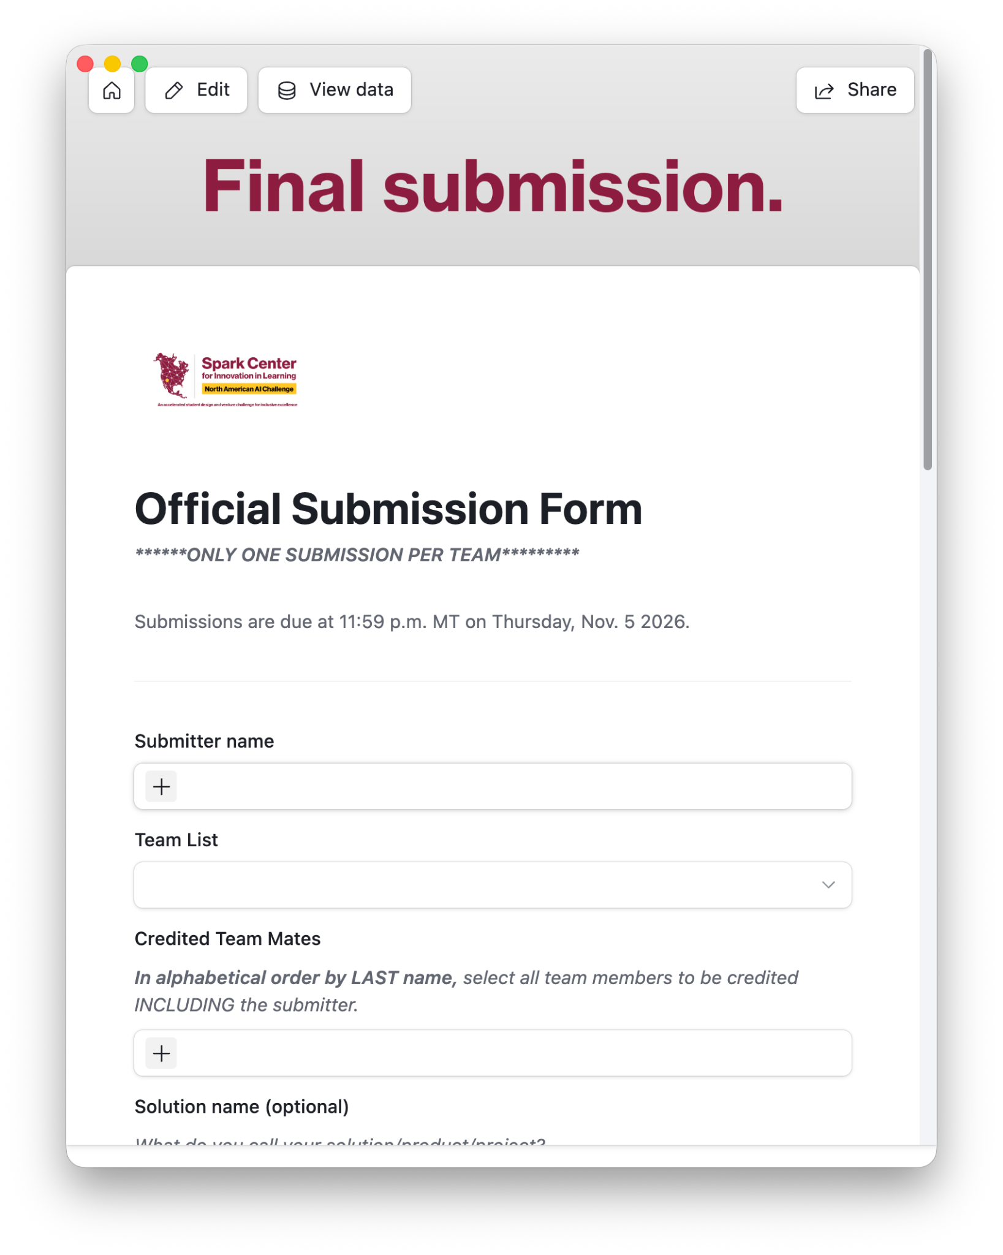
Written responses
Complete all required written responses through the official submission form. Your responses will cover:
Executive Summary
Partner Research & Insights
Future Roadmap
And more!
All challenge deliverables are due Thursday, Nov. 5 at 11:59 p.m. MT
Notes:
Executive Summary: A concise overview of your solution, target audience, and primary impact.
Partner Research & Insights: Key takeaways from your collaboration with a Challenge Partner and how their feedback informed product iterations.
Future Roadmap: Immediate next steps, scaling potential, and plans for addressing limitations discovered during prototyping.

Slide 16
Challenge rules
All teams must be pre-formed and are composed of 3-5 teammates. All teammates must submit individual registrations by Oct. 7 to be included in the challenge.
Teams are required to incorporate customer research data and/or strategies through a Challenge Partner, a vetted organization from a curated list of institutions, programs, or service providers supporting neurodivergent individuals.
Teams are required to create a functional minimum viable prototype (FMVP) that incorporates AI and customer research conducted through a Challenge Partner.
FMVP submissions must be original work completed within the 2-week challenge sprint.
Team submissions are due by the submission deadline. No extensions will be granted.
Teams agree to pitch live at a regional Launchpad by Nov. 7. At least 2 members of your team should be present.
Submissions will undergo a code review. Organizers reserve the right to disqualify any team and revoke their advancing status if their code is found to be unreadable, fraudulent, or unoriginal.
The official submission and presentation language is English. Please ensure your final submission materials and presentation are delivered in English.

Slide 17
Grounds for Disqualification
Partner Non-Compliance Failing to engage with Challenge Partners or follow Partner rules.
Working closely with our sponsors and mentors is a core expectation of this competition. Teams are required to actively communicate with assigned Challenge Partners and strictly follow all venue, sponsor, and safety guidelines throughout the event.
Solo Participation Working individually rather than as a team.
This challenge is designed to foster collaboration and collective problem-solving. Every entry must consist of two or more members; individual entries or "teams of one" are not permitted and will be disqualified from judging.
Missed Deadlines
Team Form submission (by 3:30 p.m. today)
Progress reports, daily through Nov. 5
Final challenge completion, due 11:59 p.m. on Nov. 5
Code Authenticity & Originality Project authenticity is required.
Codebases must not be entirely AI-generated, and teams must maintain a "human in the loop" who can review, explain, and validate all submitted code. All work must be original to this event. If a submission is found to bear substantial resemblance to a project previously submitted at another hackathon or repository, the team will face immediate disqualification, forfeiture and revocation of any awards or competition standings (even retroactively), and potential barring from future events.
Notes:
We encourage teams to leverage modern tools and AI assistance to optimize their workflow and boost efficiency. However, projects that consist entirely of AI-generated code bases will not be accepted. We require a "human in the loop"—you must actively review, authenticate, test, and understand your codebase. Judges reserve the right to ask team members to explain the logic, architecture, and implementation details of their code. If a team cannot clearly explain how their submission works, it will be treated as non-authentic work.
Originality & Prior Work Resubmission
All projects submitted must be original work created during this event. If a codebase is found to bear substantial resemblance to a project previously submitted at a prior hackathon or existing public repository, strict penalties will apply:
Immediate Disqualification: The team will be immediately removed from the competition regardless of current standing (actively hacking, advancing to finals, or already awarded a prize).
Revocation of Awards: Any prizes, titles, or standings previously awarded will be fully rescinded.
Future Eligibility: Team members may face a permanent bar from entering future events or hackathons hosted by our organization.

Slide 18

Join the Discord!
discord.gg/A9KADDwKw

Slide 19

Presenter Packet
Required slide deck & timer
Rubric
Handbook
Doc with links to Discord, Airtable pages
shorturl.at/wpxeU

Slide 20
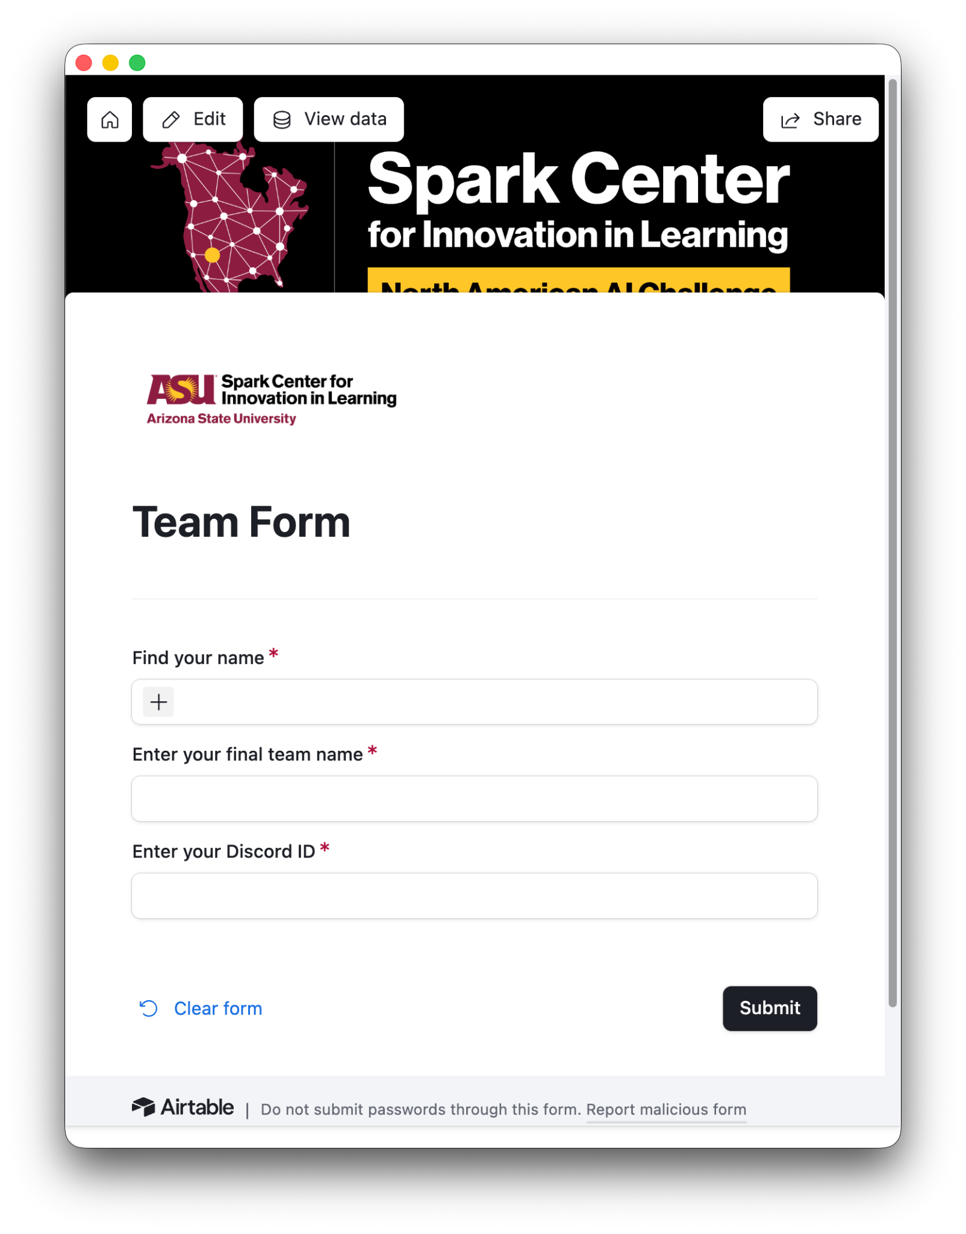
Team Form
Steps to complete:
Select your name.
Enter your Team Name.
Make sure it’s spelled correctly!
Enter your Discord ID.
All team members must complete the Team Form by 3:30 p.m. MT today.
Notes:
https://airtable.com/appTfuhA8WpKrD1wx/pag7Jvgggday92fHD/form
The team form is very simple - enter your name and team name, followed b your DSicord ID. We’ll work to make team channels for you on Discord so you can keep in touch. You’re also welcome to create group chats, emails, whatever works for your new team.

Slide 21
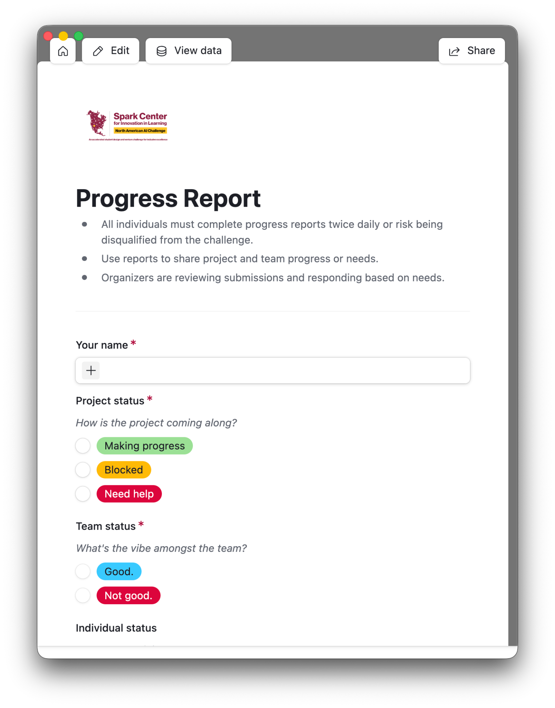
Progress Reports
Progress reports help us monitor team progress and cohesion across the initial design sprint.
Steps to complete:
Select your name from the list.
Enter progress details for the team and for yourself.
Submit in the AM and in the PM, daily.
Between Oct. 25 - Nov. 5, all individuals must submit Progress reports twice daily.
Notes:
https://airtable.com/appTfuhA8WpKrD1wx/pag7Jvgggday92fHD/form
The team form is very simple - enter your name and team name, followed b your DSicord ID. We’ll work to make team channels for you on Discord so you can keep in touch. You’re also welcome to create group chats, emails, whatever works for your new team.

Slide 22
Submission Form
Due Thursday, Nov. 5 at 11:59 p.m. MT
Steps to complete:
Select one person to submit on behalf of the team.
Upload all required links/documentation.
Enter written responses.
Submit by 11:59 p.m. MT on Thursday, Nov. 5, 2026.
Access Permissions: Set sharing permissions to set to public/accessible by all.
Notes:
https://airtable.com/appTfuhA8WpKrD1wx/pag7Jvgggday92fHD/form
The team form is very simple - enter your name and team name, followed b your DSicord ID. We’ll work to make team channels for you on Discord so you can keep in touch. You’re also welcome to create group chats, emails, whatever works for your new team.

Slide 23
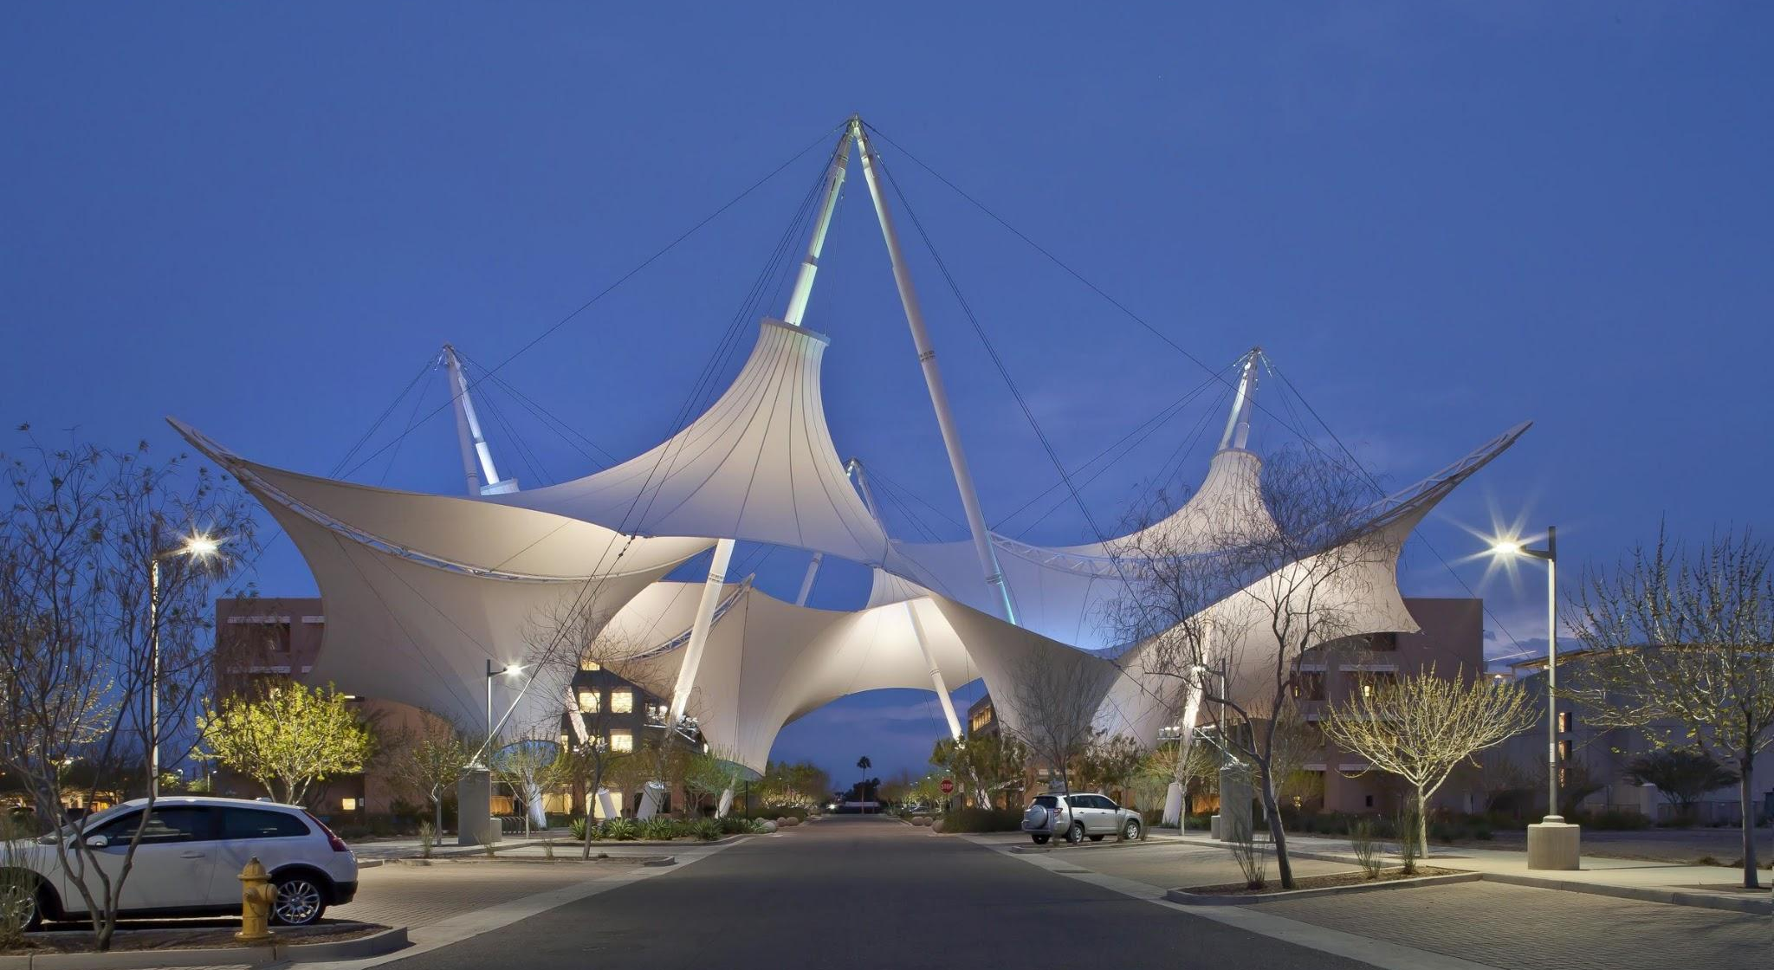
UPDATED FOR 2026!
Scottsdale Launchpad
Skysong Innovations, Scottsdale, AZ (map)
Friday, Nov. 6, 2026
4:00 p.m. - 8:00 p.m.
Parking: free, ample
Notes:
Photos can be replaced to support your presentation.
Find additional images to use for this slide

Slide 24
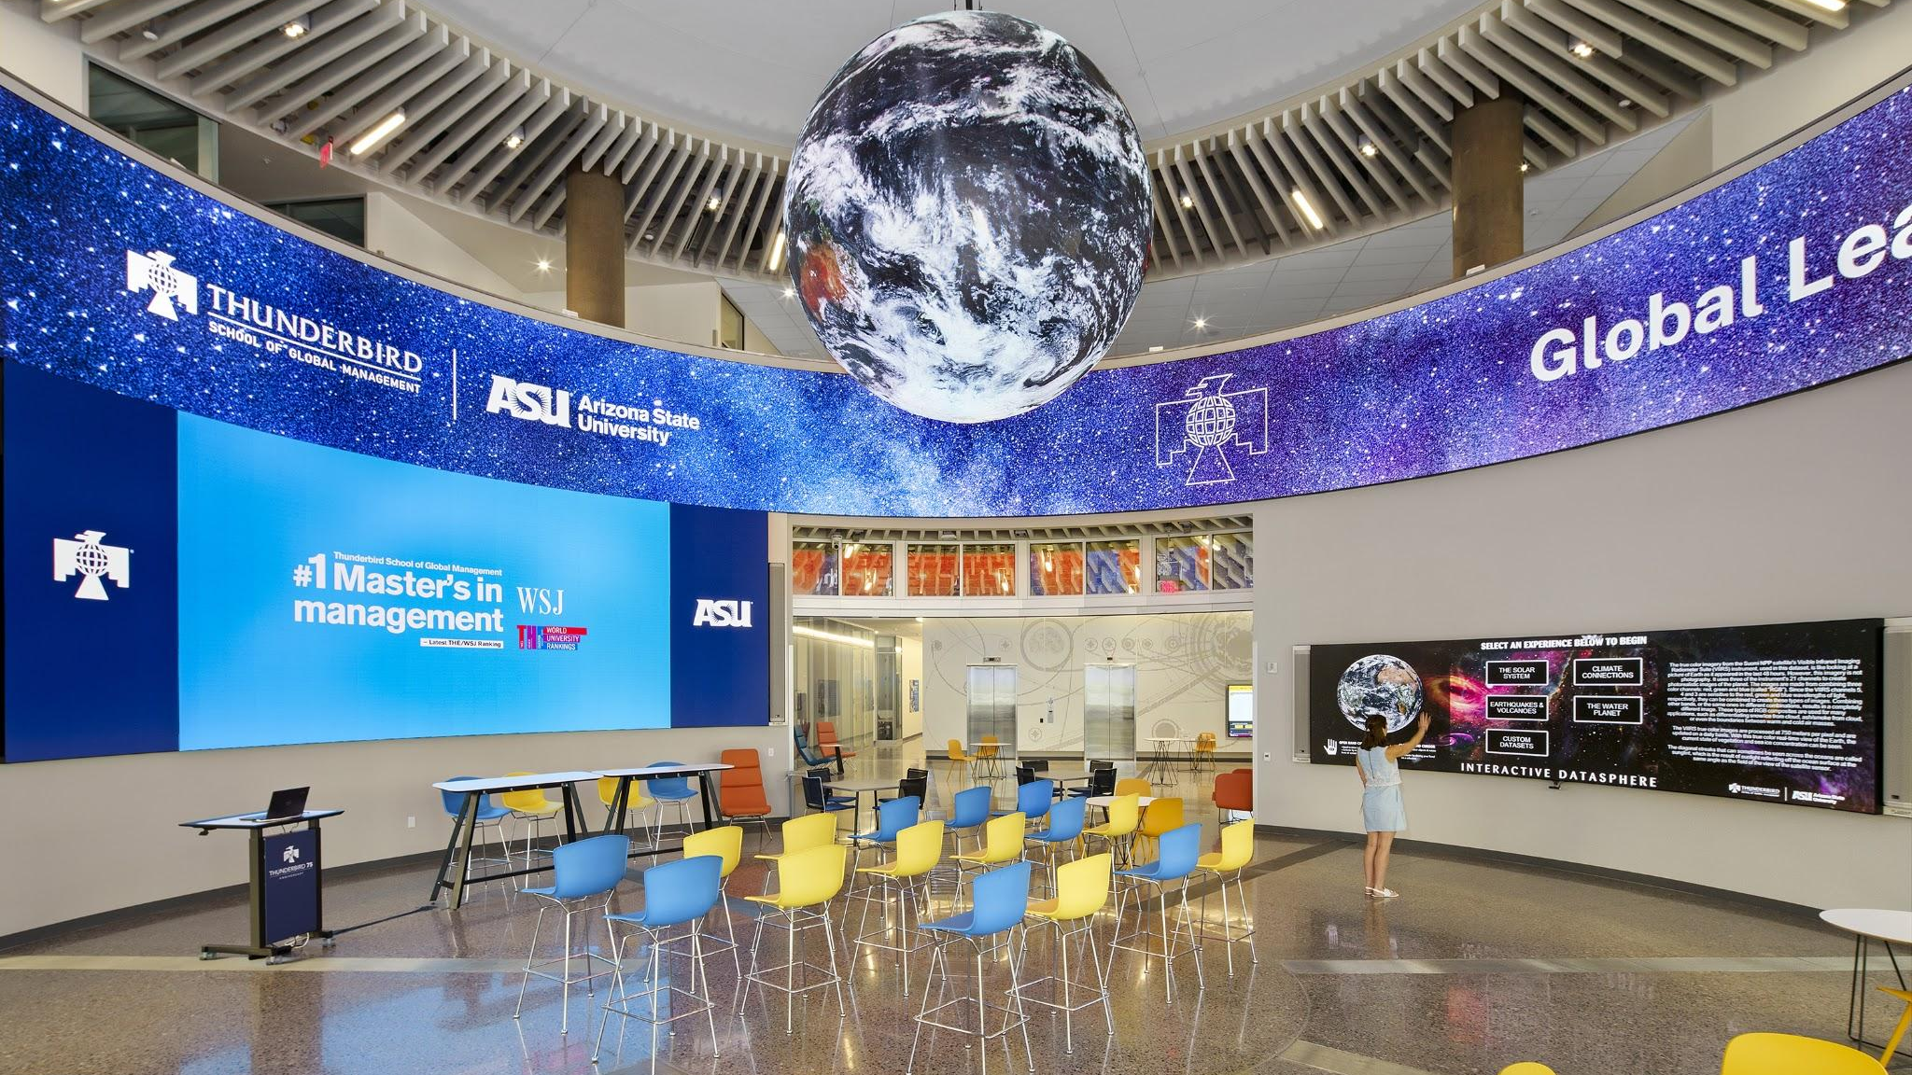
UPDATED FOR 2026!
Grand finale Saturday, Nov. 21, 2026 4:00 - 8:00 p.m. MT Thunderbird School of Global Management Phoenix, AZ
Notes:
NOTE: The vertical gold bar should remain the same height as the white text box area.
Photos can be replaced to support your presentation.
Find additional images to use for this slide

Slide 25
ASU Charter
ASU is a comprehensive public research university, measured not by whom it
excludes, but by whom it includes and how they succeed; advancing research and discovery of public value; and assuming fundamental responsibility for the
economic, social, cultural and overall
health of the communities it serves.
Notes:
Always start with the official ASU presentation template

Slide 26
Nine design aspirations guide ASU’s ongoing evolution as a New American University. ASU integrates these institutional objectives in innovative ways to demonstrate excellence, access and impact.
Leverage our place ASU embraces its cultural, socioeconomic and physical setting. | Fuse intellectual disciplines ASU creates knowledge by transcending academic disciplines. | Be socially embedded ASU connects with communities through mutually beneficial partnerships.
Transform society ASU catalyzes social change by being connected to social needs. | Conduct use-inspired research ASU research has purpose and impact. | Engage globally ASU engages with people and issues locally, nationally and internationally.
Value entrepreneurship ASU uses its knowledge and encourages innovation. | Enable student success ASU is committed to the success of each unique student. | Practice Principled Innovation ASU places character and values at the center of decisions and actions.
Notes:
Always start with the official ASU presentation template

Slide 27
ASU’s 9th Design Aspiration
Practice Principled Innovation
ASU places character and values at the center of decisions and actions
Notes:
Character - “the mental and moral qualities distinctive to an individual.”
Values - “a person's principles or standards of behavior; one's judgment of what is important in life.”

Slide 28
Character
“the mental and moral qualities distinctive to an individual.”
Values
“a person's principles or standards of behavior; one's judgment of what is important in life.”
Notes:
Character - “the mental and moral qualities distinctive to an individual.”
Values - “a person's principles or standards of behavior; one's judgment of what is important in life.”

Slide 29
Practicing Principled Innovation: Values Reflection
Activity
Notes:
Decision-Making Guide: https://docs.google.com/document/d/1-zYfewpEUgaKLmgZY4-2CKyH7UQH8E4cV7Np3_fSwag/edit?usp=drive_web&ouid=114214768696284849113
[Print for activity] Companion Guide: https://docs.google.com/document/d/1xc62V4nQUxjagiuoNZO82cv7D_rjkTrhHAntmItOL44/edit?tab=t.0

Slide 30
Activity: Values Reflection
Think of a time when you faced a difficult decision or challenge—at school, at work, or as part of a team—and there wasn’t an obvious right answer.
What values shaped how you responded? How did those values influence the choices you made? Select your top three.
Perseverance Reflection Resilience Curiosity Integrity Humility Motivation | Volunteering Judgement Leadership Justice Gratitude Community awareness Reasoning | Teamwork Service Resourcefulness Confidence Compassion Respect Civility | Courage Citizenship Determination Neighborliness Critical Thinking Honesty Autonomy
Other(s)?

Slide 31
Debrief and Reflection
In the chat, share your top three values.
Let’s hear from a few people: What led you to select these values? How have these values shaped the way you approach decisions or challenges?
Self-reflection
How might your values influence the way you approach this AI Challenge: what you prioritize, the decisions you make, and what you ultimately choose to create?

Slide 32
Practicing Principled Innovation: Character Assets
Activity
Notes:
Decision-Making Guide: https://docs.google.com/document/d/1-zYfewpEUgaKLmgZY4-2CKyH7UQH8E4cV7Np3_fSwag/edit?usp=drive_web&ouid=114214768696284849113
[Print for activity] Companion Guide: https://docs.google.com/document/d/1xc62V4nQUxjagiuoNZO82cv7D_rjkTrhHAntmItOL44/edit?tab=t.0

Slide 33
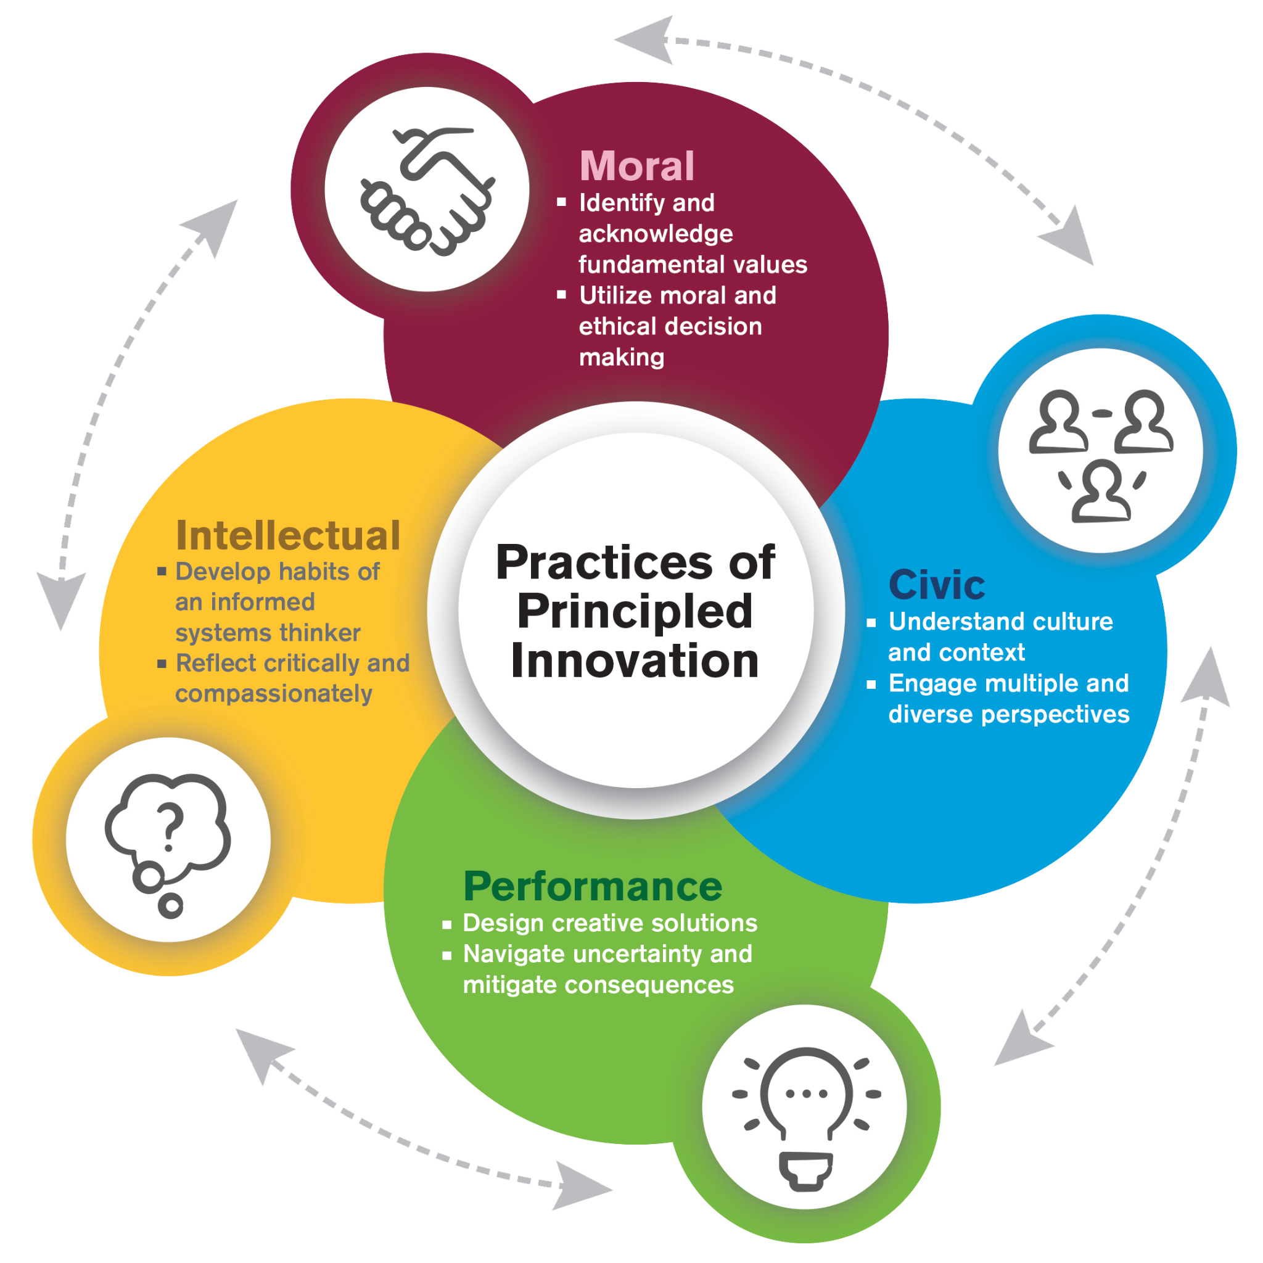
Principled Innovation Model
Principled Innovation is the ability to imagine new concepts, catalyze ideas, and form new solutions guided by principles that create positive change for humanity. The question, “We can innovate, but should we?” places values and ethical understandings at the core of the practice.
Principled Innovation recognizes four interconnected character assets – moral, civic, intellectual, and performance – that are developed over one’s lifetime through self-reflection, working with others, and learning through experiences.

Slide 34
Activity: PI Character Assets as a Challenge Navigation Tool
Read the provided scenario.
With your breakout group, respond to the scenario using the prompts for your assigned character asset (moral, civic, performance, intellectual).
Be ready to share your responses to the prompt with the larger group.
Notes:
https://docs.google.com/presentation/d/1xsup9vLE-HAyZrMvk9KRu7_F53SJLGifkVv7n3BLDpY/edit?usp=sharing

Slide 35
Scenario: Whose Problem Are We Solving?
Your team has a great idea for an AI tool. It's innovative, technically feasible, and your team is confident you can build a strong prototype within two weeks.
Then you meet with your Challenge Partner. The people they serve don't seem particularly interested in your idea. Instead, they describe a different problem—one that's less exciting technologically and may require your team to rethink much of what you've already planned. You have limited time and a competition to win.
Do you keep building, modify your idea, or start over?
What values should guide your decision?
Notes:
https://docs.google.com/presentation/d/1xsup9vLE-HAyZrMvk9KRu7_F53SJLGifkVv7n3BLDpY/edit?usp=sharing

Slide 36
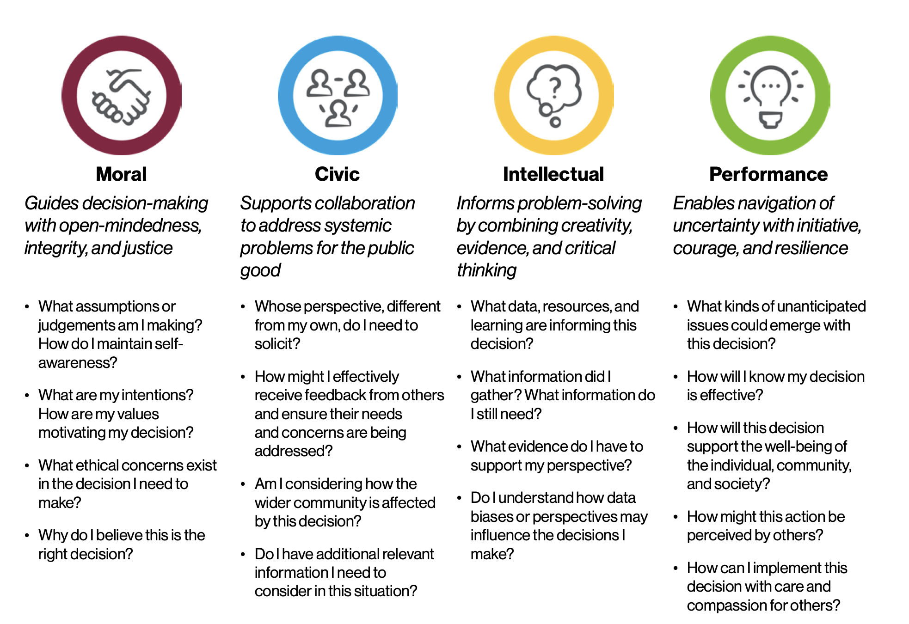
PI Character Assets
Notes:
https://docs.google.com/presentation/d/1xsup9vLE-HAyZrMvk9KRu7_F53SJLGifkVv7n3BLDpY/edit?usp=sharing

Slide 37
Debrief and Reflection
Share 1-2 highlights of your breakout group conversation.
Self-reflection
How did this activity cause you to think deeper about the problem than if I had simply asked your group, ‘What should you do?’
PI doesn't necessarily give us the answer; it changes the quality of the questions we ask before acting.

Slide 38
Practicing Principled Innovation: Resources
Engagement

Slide 39
Principled Innovation Resources
How to get started engaging with Principled Innovation
Practice Principled Innovation website
Principled Innovation Toolkit Library
Communities of Practice
Foundations Course
https://pi.education.asu.edu/communities-of-practice/
Overview of Community of Practice theory and practice, and how Principled Innovation fundamentals are embedded into this approach.
https://pi.education.asu.edu/resources/foundations-course/
Free, self-paced course that provides an introduction to the concept of Principled Innovation.
pi.asu.edu
ASU design aspiration website describing the context, stories and projects of Principled Innovation across the university.
https://pi.education.asu.edu/resources/pi-library/
Online toolkit library of 200+ resources to get started on engaging with Principled Innovation.
Principled Innovation Card Decks
Principled Innovation Discovery Dice
Principled Innovation Continuum
The Principled Innovation® Bot
https://pi.education.asu.edu/pi-card-deck/
Interactive card decks designed to inspire positive and reflective decision-making that engages core values.
https://pi.education.asu.edu/resource/principled-innovation-discovery-dice-game/
Online interactive dice game to help teams and individuals reflect on their decision-making processes.
https://pi.education.asu.edu/resource/principled-innovation-continuum
Reflective tool for individuals, teams and organizations to identify the degree to which they are currently engaging in the practices of Principled Innovation.
https://pi.education.asu.edu/resource/the-principled-innovation-bot/
Designed to serve as a thought partner, offering structured guidance in decision-making, ethical reflection and creative problem-solving through the lens of Principled Innovation.

Slide 40
Final Thoughts
Make the decision that feels like the right fit and take action. It’s better to try a solution than be paralyzed by the fear of making a mistake.
Afterwards, examine your choice…
How did it go?
What have I learned from this specific situation?
What would I do differently next time?
Reflection is a continual process and key to the development of practical wisdom as we learn from our experiences.

Slide 41
Introducing your Challenge Partners

Slide 42
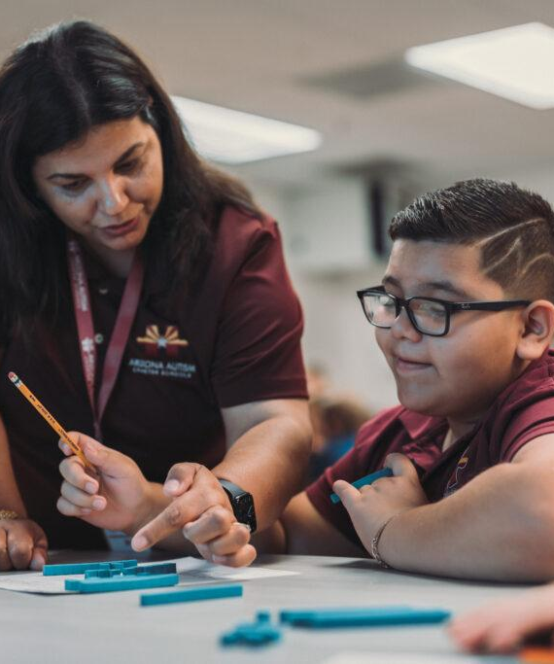
Arizona Autism
Charter Schools
United States
Arizona Autism Charter Schools (AZACS) is Arizona’s first tuition-free public charter network dedicated to serving students on the autism spectrum and other neurodivergent learners, providing specialized educational opportunities that support their academic, social, and personal development.
Established in 2013 by Diana Diaz-Harrison and a group of parents and professionals, AZACS welcomed its first students in 2014. Since then, the organization has expanded to serve students across grades K–12 through campuses in Central Phoenix, Peoria, Mesa, and Tucson, as well as online programs. Their educational approach combines evidence-based instruction, STEAM education, and project-based learning to meet the individual needs and strengths of their students.
Recognized nationally for educational excellence and innovation with the 2022 Yass Prize, AZACS remains committed to empowering students with the skills, confidence, and independence needed to reach their full potential and participate meaningfully in their communities.
Notes:
http://autismcharter.org
Founded in 2013 to service the Valley of the Sun, AZACS is Arizona’s first and only charter network specializing in serving students on the autism spectrum. AZACS is a tuition-free public charter network dedicated to serving students on the autism spectrum and other neurodivergent learners, providing specialized educational opportunities that support their academic, social, and personal development. They serve students across grades K–12 through campuses in Central Phoenix, Peoria, Mesa, and Tucson, as well as online programs. Their educational approach combines evidence-based instruction, STEAM education, and project-based learning to meet the individual needs and strengths of their students.

Slide 43
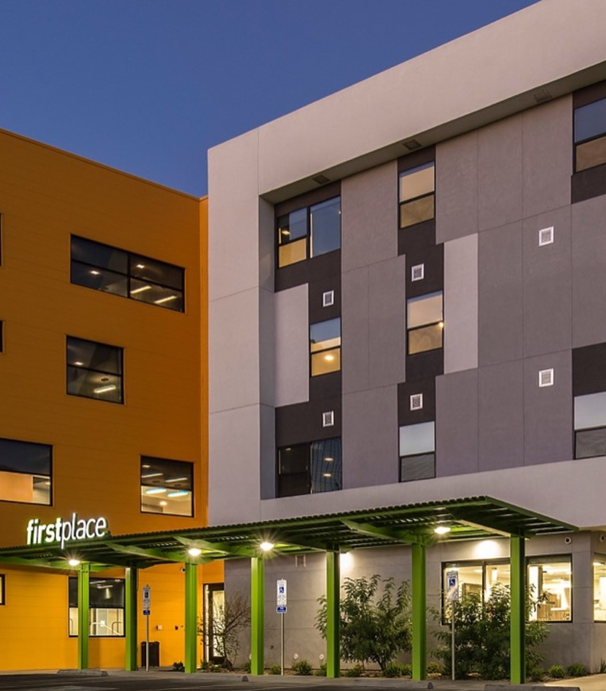
First Place AZ
United States
First Place AZ is a Phoenix-based nonprofit organization dedicated to expanding housing, community, and independent living opportunities for adults with autism and intellectual or developmental disabilities, creating supportive environments where individuals can lead meaningful and fulfilling lives.
Founded in 2012 by Denise D. Resnik, First Place AZ developed First Place–Phoenix, an innovative residential community that opened in 2018. The community offers supportive apartment living alongside the First Place Transition Academy, a two-year residential program designed to strengthen independent living skills, career readiness, and social connections. Through these initiatives, the organization helps individuals gain greater confidence, independence, and opportunities for community engagement.
Committed to advancing inclusion and improving quality of life, First Place AZ continues to promote innovative housing solutions, education, research, and collaboration, working toward a future where individuals of all abilities can find their place in the world.
Notes:
http://firstplaceaz.org/
Founded in 2012 in Phoenix, Arizona, First Place AZ is a nonprofit organization dedicated to advancing health, independence, and inclusion for autistic adults and individuals with intellectual and developmental disabilities (I/DD). Through First Place–Phoenix, the Transition Academy, and First Place Global, they develop, test, and scale innovative solutions that improve quality of life across the lifespan of over 500 community members. As a Challenge Partner, First Place provides student teams with meaningful access to research, public policy, self-advocate perspectives, and lived experience that can help inform the development of impactful, human-centered AI solutions.

Slide 44
Breakout session
Over the next 30 minutes, you’ll meet directly with our Challenge Partners to receive insights into:
The people they serve
The services they offer
How you’ll work with their communities, tools or insights over your design sprint

Slide 45
What’s next
Team channels are being created in Discord.
Change your Discord nickname to be your human name.
Sign up for appointments with Partners by their deadlines.
  First Place AZ - deadline is tonight at midnight!
  AZACS - deadline is Tuesday

